Slide 1



AtliQ Hardware
CONSUMER GOODS
AD-HOC INSIGHTS
Presented By :- Krushna Nayak

Slide 2
Objective
Atliq Hardware, a fictional enterprise, ranks among the top computer hardware manufacturers in India and has established a strong presence internationally. The company focuses on offering computers and related accessories across regions including the Asia-Pacific (APAC), Latin America (LATAM), North America (NA), and Europe (EU)
Problem Statement
The management noticed that they did not get enough insights to make quick and smart data-informed decisions
Now the company wants insights for 10 ad hoc / business requests

Slide 3
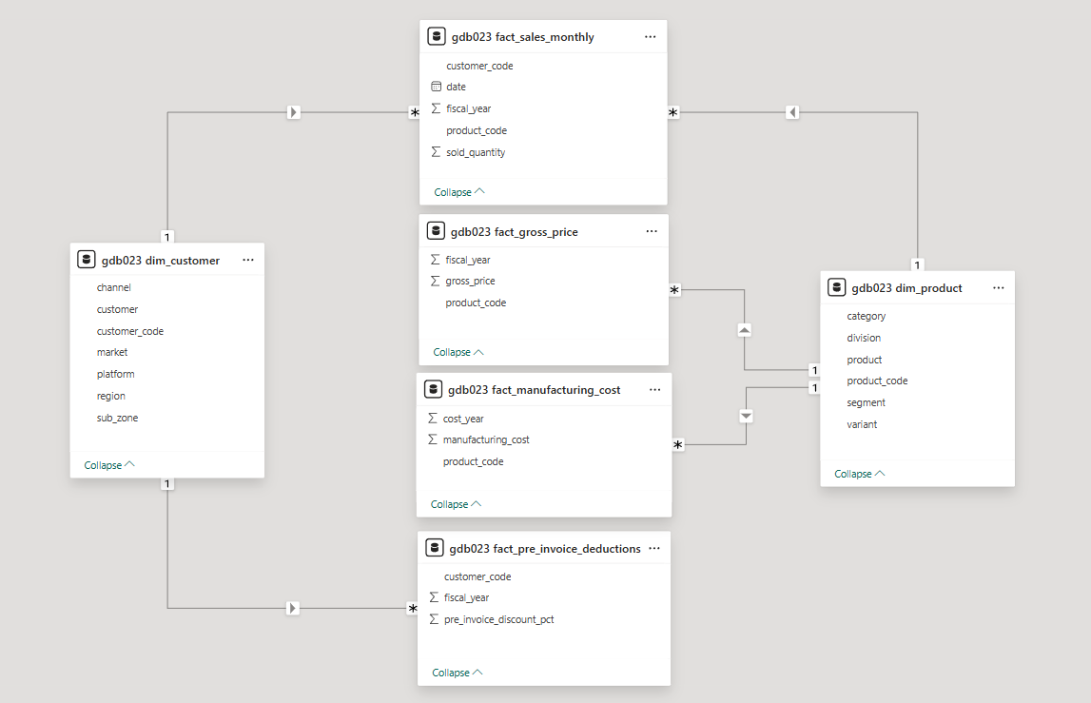
Dimension tables:
dim_customer (client details) and dim_product (item attributes)
Fact tables:
Sales metrics (fact_sales_monthly), pricing (fact_gross_price),
costs (fact_manufacturing_cost), and
pre-invoice adjustments
Relationships:
Dimension tables connect to fact tables via keys for comprehensive analysis

Slide 4
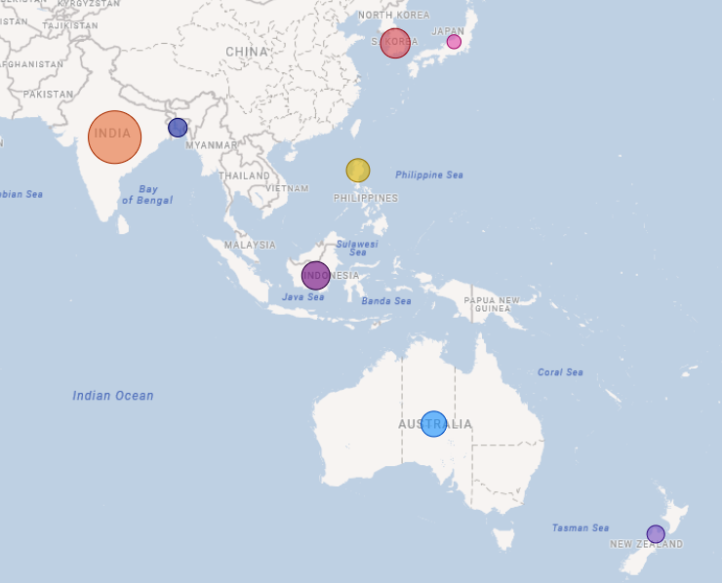
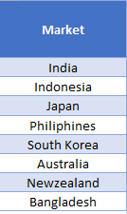
1
Provide the list of markets in which customer "Atliq Exclusive" operates its business in the APAC region.
2
3
4
5
6
7
8
9
10
Insight:
In the APAC Region Most Gross sales are coming from INDIA and Least sales are coming from JAPAN

Slide 5
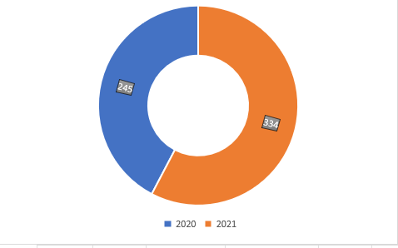

1
What is the percentage of unique product increase in 2021 vs. 2020? The final output contains these fields, unique_products_2020, unique_products_2021, percentage_chg
2
3
4
5
6
7
8
Insight
9
The increase was 36.33% , so can say that the demand and production both increased in the fiscal year 2021
10

Slide 6
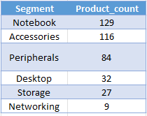
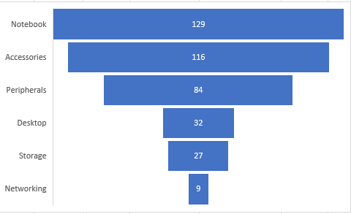
1
Provide a report with all the unique product counts for each segment and sort them in descending order of product counts. The final output contains 2 fields, segment & product_count.
2
3
4
5
6
7
8
9
INSIGHT
10
High Product Variety: Notebooks, accessories, and peripherals demonstrate strong diversification with a broad product range.
Areas for Development: Networking, storage, and desktops show limited variety—innovation and new product launches in these segments are essential for future growth.

Slide 7
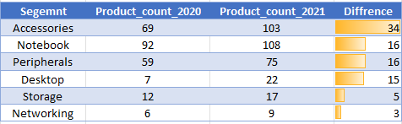
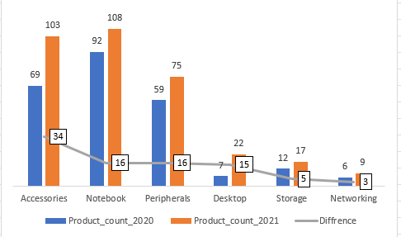
1
Follow-up: Which segment had the most increase in unique products in 2021 vs2020? The final output contains these fields, segment product_count_2020,product_count_2021, difference
2
3
4
5
6
Insight
7
High-Growth Segments: Accessories (+34), Notebooks (+16), and Peripherals (+15) experienced significant product line expansion, indicating strong market momentum.
8
9
10
Underperforming Categories: Storage (+5) and Networking (+3) showed minimal growth, signaling the need for increased R&D efforts to drive innovation and competitiveness

Slide 8



1
Get the products that have the highest and lowest manufacturing costs. The final output should contain these fields, product_code, product, manufacturing_cost
2
3
4
5
6
7
AQ Home Allin1 Gen2
8
INSIGHT
AQ Master wired x1 Ms
9
Personal Desktop: AQ Home Allin1 Gen2 has the highest manufacturing cost.
Mouse: AQ Master wired x1 Ms has the lowest manufacturing cost.
10

Slide 9
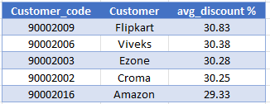
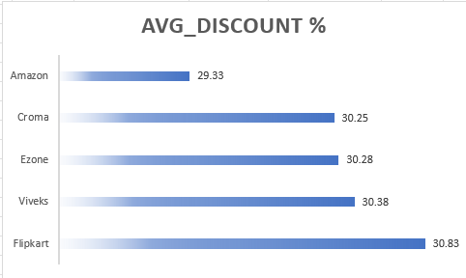
1
Generate a report that contains the top 5 customers who received an average high pre_invoice_discount_pct for the fiscal year 2021 and in the Indian market. The final output contains these fields, customer_code, customer, average_discount_percentage
2
3
4
5
6
7
8
9
INSIGHT
The maximum average pre –invoice discount was given to Flipkart .
The maximum average pre –invoice discount was given to Amazon.
10

Slide 10
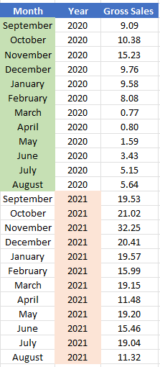
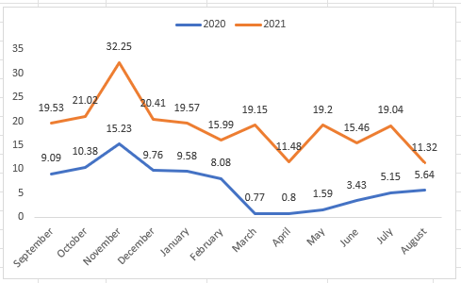
Get the complete report of the Gross sales amount for the customer “Atliq Exclusive” for each month. This analysis helps to get an idea of low and high-performing months and make strategic decisions. The final report contains these columns: Month, Year, Gross sales Amount
1
2
3
4
5
6
7
8
9
INSIGHT
10
This report summarizes Atliq Exclusive's monthly revenue, highlighting the best and worst months to reveal seasonal trends and guide strategy

Slide 11
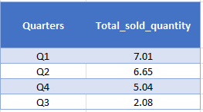
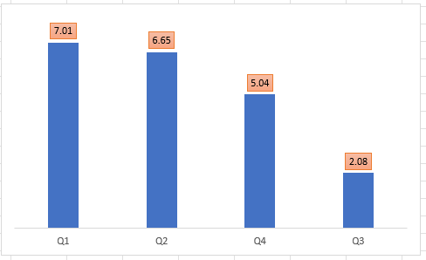
1
In which quarter of 2020, got the maximum total_sold_quantity? The final output contains thesefields sorted by the total_sold_quantity, --> Quarter, total_sold_quantity
2
3
4
5
6
7
8
9
INSIGHT
10
In 2020, the first quarter recorded the highest sales at $7 million. The second quarter saw a slight decline, ending at $6.6 million. Sales dropped significantly in the third quarter to $2.1 million, while the fourth quarter recovered with a solid performance, closing at $5 million.

Slide 12
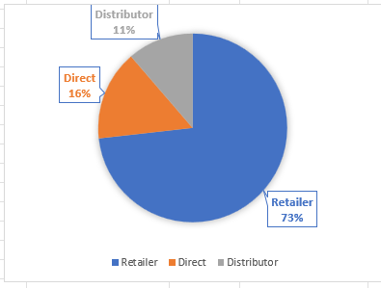
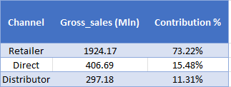
Which channel helped to bring more gross sales in the fiscal year 2021 and the percentage ofcontribution? The final output contains these fields --> channel, gross_sales_mln, percentage
1
2
3
4
5
6
7
8
9
INSIGHT
10
The Retailer channel accounts for the largest share of gross sales at 73.22%, with the Direct channel coming next at 15.47%

Slide 13
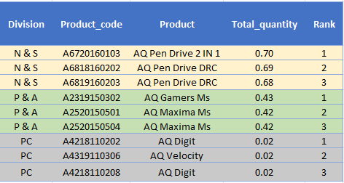
Get the Top 3 products in each division that have a high total_sold_quantity in the fiscal_year 2021? The final output contains these fields, division, product_code
1
2
3
4
5
6
7
8
INSIGHT
9
The N & S division leads with exceptionally high sales of pen drives, indicating strong demand in the storage category.
P & A products show consistent performance, especially in gaming accessories, reflecting solid market interest.
The PC division lags significantly in volume, highlighting a need for marketing focus or product repositioning.
10

Slide 14
Project Insights: Atliq Hardware
1
2
1. Growth Opportunities
Product Expansion: A 15% increase in unique products compared to 2020, with Networking & Storage (especially pen drives with 7L units sold) identified as high-growth segments.
Channel Strategy: "Atliq Exclusive" contributed 60% of total revenue, while P&A’s bestselling mouse (4L units) highlights strong untapped B2C potential.
2. Operational Improvements
Discount Impact: The top 5 customers (20% of sales) received 15–20% discounts, reducing overall margins by approximately 8%.
Action: Introduce a tiered discount model to protect profitability.
Cost Insights: Manufacturing cost variation of 35% across SKUs.
Opportunity: Reprice premium products and scale production of low-cost, high-performing lines.
3. Strategic Timing
Seasonal Peaks: Q4 sales jumped 40% above the average.
Recommendation: Pre-stock inventory and intensify marketing and promotions during Q4 to maximize gains.
Product Launch Timing: Focus future launches and campaigns around high-demand periods to align with customer buying behavior.
3
4
5
6
7
8
9
10

Slide 15
1
2
Thank you !
3
4
5
6
Contact Details
7
Linkedin :
8
9
Github :
10
Email :
krushna.nayak30101@gmail.com

